Slide 1
The Assembler
Based on “The Elements of Computing Systems”, Nisan & Schocken, MIT Press, forthcoming in 2004, www.idc.ac.il/tecs
project 7
Yana Gabelev

Slide 2
Links
Project 7:
http://my.jce.ac.il/~arikgi/Web/Ex/Ex07/index.htm
EX07 zip :
http://my.jce.ac.il/~arikgi/Web/Ex/Ex07/Ex07.zip

Slide 3
Binary code (.hack)
Each line is a sequence of 16 “0” and “1” ASCII characters, coding a single 16-bit machine language instruction.
Taken together, all the lines in the file represent a machine language program.

Slide 4
Assembly language (.asm)
Each line representing either an instruction or a symbol declaration:
Instruction: consists of two instruction types: an A-instruction or a C-instruction
(Symbol): This pseudo-command binds the Symbol to the memory location into which the next command in the program will be stored. It is called “pseudo-command” since it generates no machine code.

Slide 5
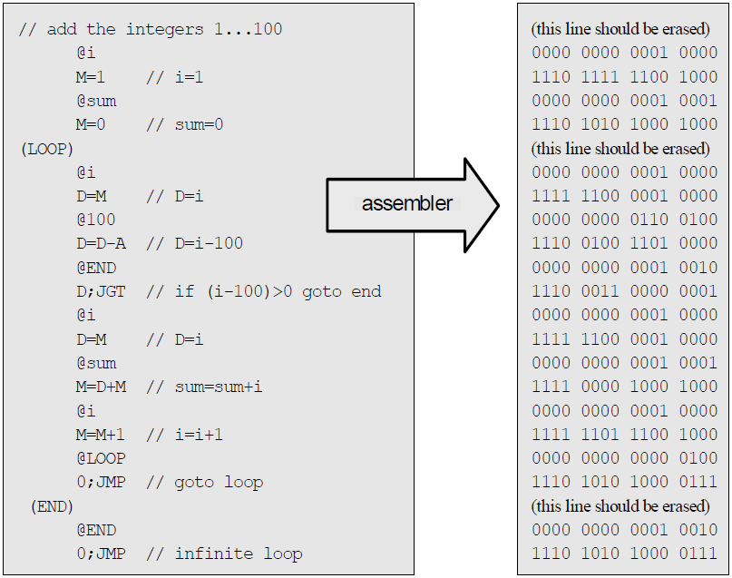
Example
Assembly code (Prog.asm)
Binary code (Prog.hack)

Slide 6

A-instruction (addressing instruction )
@value
value is either a non-negative decimal number or a symbol referring to such number.
Binary:

Slide 7

C-instruction (compute instruction )
dest = comp ; jump
Either the dest or jump fields may be empty:
If dest is empty, the "=" is ommitted;
If jump is empty, the ";" is omitted.
Binary:

Slide 8
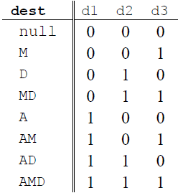
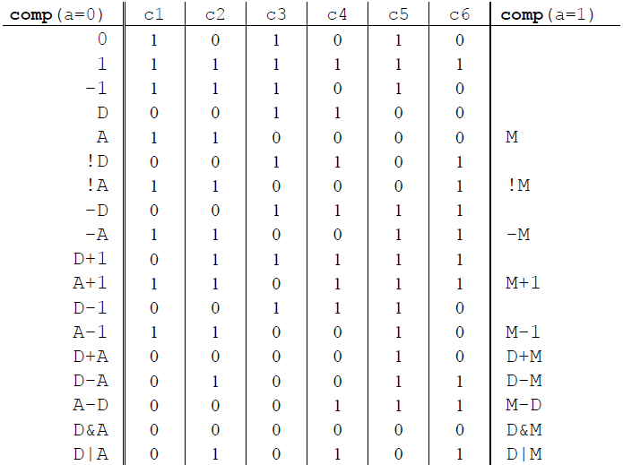
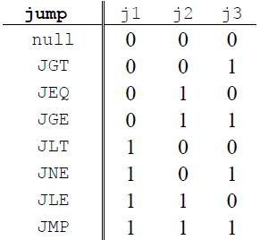
Binary forms

Slide 9
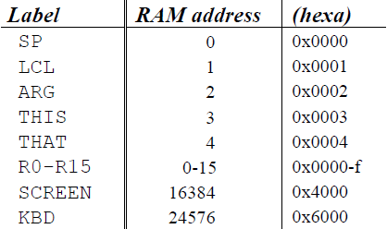
Symbols
Predefined symbols:
Label symbols: The pseudo-command “(Xxx)” defines the symbol Xxx to refer to the instruction memory location holding the next command in the program.
Variable symbols: Any symbol Xxx appearing in an assembly program that is not predefined and is not defined elsewhere using the “(Xxx)” command is treated as a variable.

Slide 10
Twist
Every C command is translated to a binary number starting with 111. The 2nd and 3rd bits are redundant. We will use them to add functionality: The operator $ that is operating on the COMP part ($COMP). In the binary number we will zero the 2nd bit the operator can appear as $COMP. Examples (shown only the first 3 bits of the binary): D=$D+1 → 101 $D+A; JLT → 101
You should extend the addition command, to support reversing the order: A+D=D+A etc.

Slide 11
Implementation
The Hack assembler reads as input a text file named Xxx.asm, containing a Hack assembly program, and produces as output a text file named Xxx.hack, containing the translated Hack machine code.
We propose implementing the Assembler using a main program and three modules:
Parser
Code
SymbolTable
Stage I: Build a basic assembler for programs with no symbols
Stage II: Extend the basic assembler with symbols

Slide 12
The Parser Module
Encapsulates access to the input code.
Reads an assembly language command, parses it, and provides convenient access to the command's components (fields and symbols).
In addition, removes all white space and comments.

Slide 13
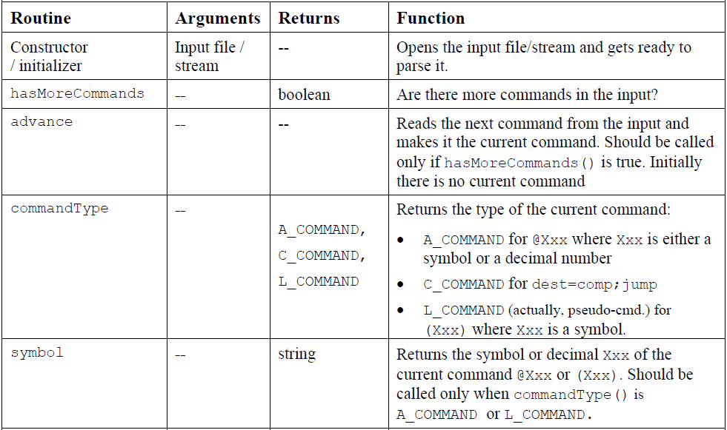

Slide 14
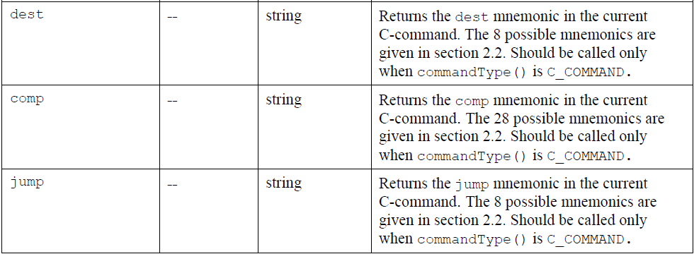

Slide 15
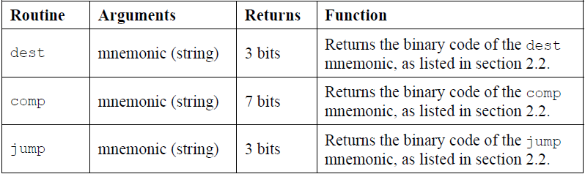
The Code Module
Translates Hack assembly language mnemonics into binary codes.

Slide 16
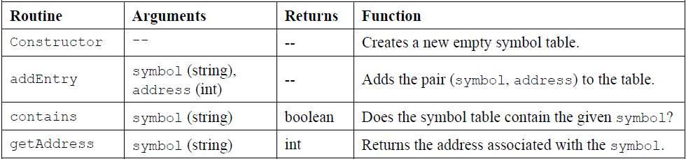
The SymbolTable Module
A symbol table that keeps a correspondence between symbolic labels and numeric addresses.

Slide 17
Assembler for programs with symbols
There are three types of symbols in the Hack language:
Pre-defined symbols;
Labels;
Variables.
The symbol table should contain and handle all these symbols, as follows.
Initialization;
First pass;
Second pass.
Notes:
Assembly programs are allowed to use symbolic labels (destinations of goto commands) before the symbols are defined. This convention makes the life of assembly programmers easier and that of assembler developers harder.

Slide 18
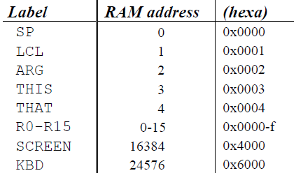
Initialization
Initialize the symbol table with all the pre-defined symbols and their pre-allocated RAM addresses.
Note that each one of the top five RAM locations can be referred to using two pre-defined symbols. For example, either R2 or ARG can be used to refer to RAM[2].

Slide 19
First pass
This pass results in entering all the program’s labels along with their ROM addresses into the symbol table.
Go through the entire assembly program, line by line, and build the symbol table without generating any code.
As you go through the program lines, keep a running number recording the ROM address into which the current command will be eventually loaded. This number starts at 0 and is incremented by 1 whenever a C-instruction or an A-instruction is encountered, but does not change when a label pseudo-command or a comment is encountered.
Each time a pseudo command “(Xxx)” is encountered, add a new entry to the symbol table, associating Xxx with the ROM address that will eventually store the next command in the program.

Slide 20
Second pass
This pass handle the variables.
Go again through the entire program, and parse each line.
Each time a symbolic A-instruction is encountered, i.e. “@Xxx” where Xxx is a symbol and not a number, look up Xxx in the symbol table.
If the symbol is found in the table, replace it with its numeric meaning and complete the command’s translation.
If the symbol is not found in the table, then it must represent a new variable. To handle it, add the pair (Xxx, n) to the symbol table, where n is the next available RAM address, and complete the command’s translation. The allocated RAM addresses are running, starting at address 16 (just after the addresses allocated to the pre-defined symbols).

Slide 21
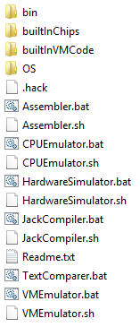
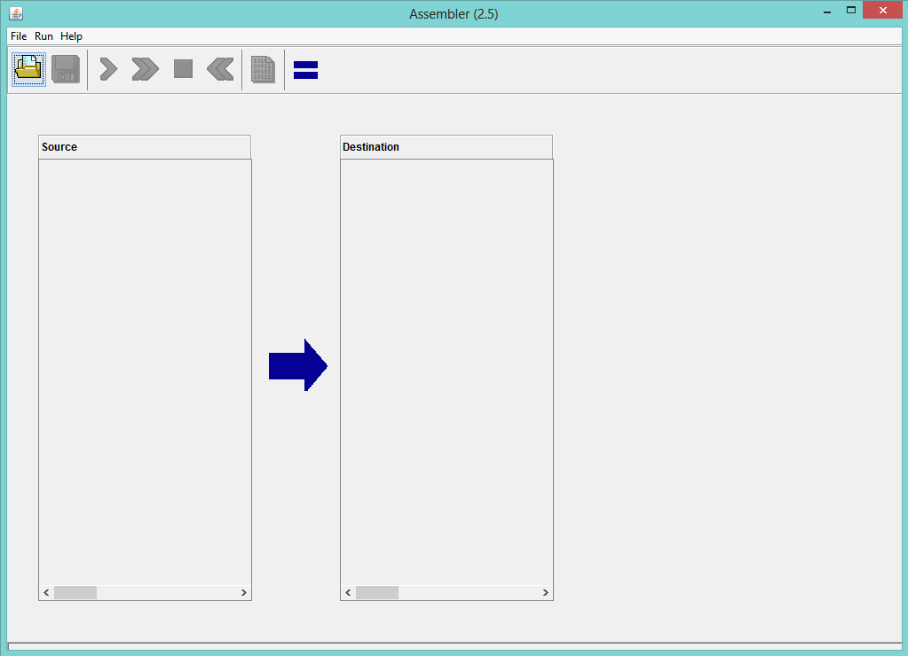
Load the compare file Xxx.hack (yours)
Load source Xxx.asm

Slide 22
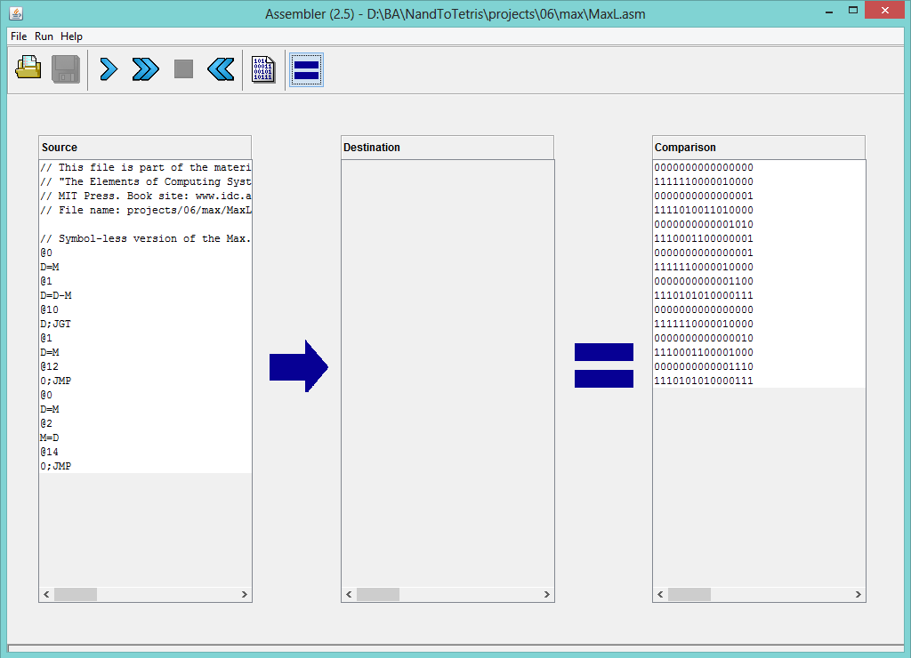
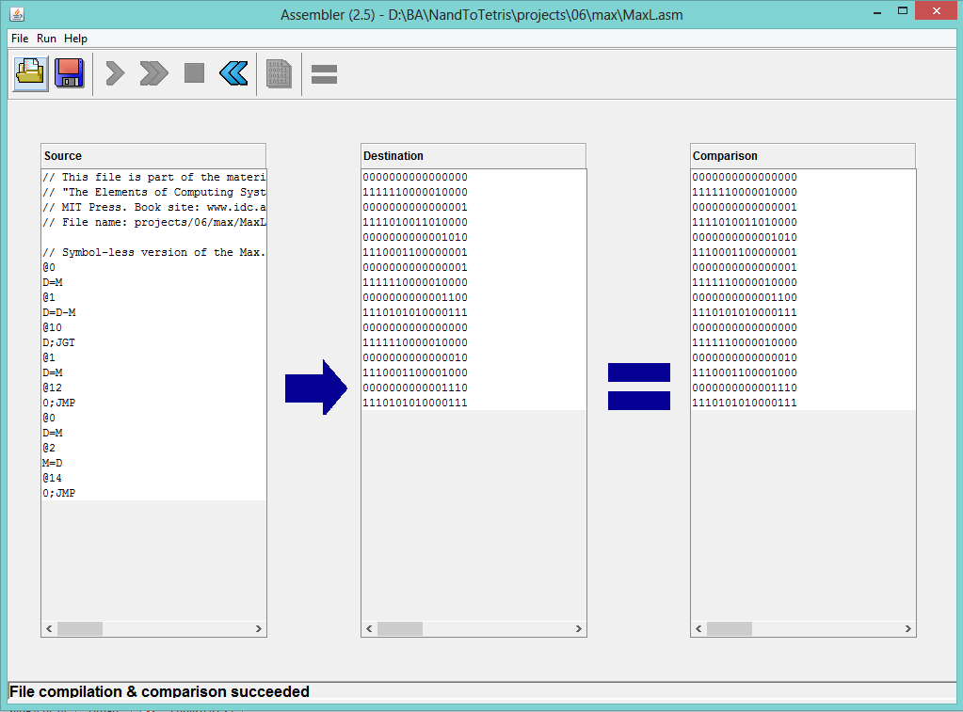
Run fast translation

Slide 23
How and what to submit
Create a folder named 2015B_exXX_YYYYYYYY, when XX is the ex number, and YYYYYYYY is your ID.
For example: 2015B_ex07_123456789
All submission files should be in that folder, and no other extra file. Files to submit: source files, README.txt
Zip the folder to a zip file named 2015B_exXX_YYYYYYYY.zip

